Slide 1


DPD Real Estate
Business Profile
Phone: +971585584499
Email
info@dpdrealestate.com

Slide 2

Who we are…?
AT DPD REAL ESTATE, we strive to be your trusted partner in navigating the vigorous real estate market in the UAE, whether you are buying properties, renting properties, or selling properties. Our mission is to provide exceptional service and expert guidance in off-plan projects, ensuring a seamless experience for our clients.
We love our customers, so feel free to visit during normal business hours whether you're interested in buying properties, renting properties, or selling properties.
DPD REAL ESTATE
Phone: +971585584499
Email: info@dpdrealestate.com

Slide 3
Company overview
DPD Real Estate LLC is a premier, fully licensed real estate brokerage and consultancy firm operating across the United Arab Emirates. We specialize in delivering secure, transparent, and trusted real estate services, with a core focus on secondary market properties and premium off-plan projects. Our mission is to empower investors and end users by providing expert guidance, robust due diligence, and end-to-end transactional support, ensuring every client’s journey is seamless, protected, and profitable.
License:
Held under the relevant UAE emirate’s Economic Department and regulated by the Real Estate Regulatory Agency (RERA).
Operational Hubs:
Dubai, Abu Dhabi, Sharjah, Ajman, Umm AL Quwain, Ras Al Khaimah.
DPD REAL ESTATE
Phone: +971585584499
Email: info@dpdrealestate.com

Slide 4
Our core services
TRUSTED OFFPLAN PROJECT MARKETING & SALES
We act as an official sales partner for reputable, RERA-approved developers. Our off-plan portfolio is carefully curated to include only projects from developers with strong track records and projects registered under the UAE’S ESCROW LAW, guaranteeing financial security.
Services:
Project selection, unit reservation, payment plan negotiation, and progress monitoring.
Value:
We provide unbiased market analysis, projected ROI reports, and ensure all contracts are transparent and legally sound.
SECONDARY MARKET PROPERTY TRANSACTIONS
Full-service brokerage for buying, selling, and leasing residential and commercial properties.
Valuation & Listing:
Accurate market valuation using advanced analytics.
Buyer Representation:
Comprehensive property viewing, rigorous due diligence (including title deed checks, service charge audits, and pending liability verification), and negotiation.
Seller Representation:
Strategic marketing, qualified lead generation, and transaction management.
DPD REAL ESTATE
Phone: +971585584499
Email: info@dpdrealestate.com

Slide 5
Our core services
INVESTMENT CONSULTANCY & PORTFOLIO MANAGEMENT
Tailored advice for institutional and high-net-worth investors.
Market Intelligence:
In-depth reports on market trends, emerging areas, and yield analysis.
Portfolio Strategy:
Acquisition, diversification, and disposal strategies.
Asset Management:
Oversight of property performance, tenant relations, and maintenance.
PROPERTY MANAGEMENT (VIA TRUSTED PARTNER)
Connecting landlords with certified property management firms for seamless lease management, maintenance, and compliance
DPD REAL ESTATE
Phone: +971585584499
Email: info@dpdrealestate.com

Slide 6
DPD Security and security Framework
Our commitment to security is embedded in every transaction:
REGULATORY COMPLIANCE & TRANSPARENCY
RERA GOVERNANCE:
All our brokers are RERA-Certified, bound by a strict code of ethics.
Escrow Account Compliance:
off-plan sales, client funds are only transferred to the developer’s RERA-mandated Escrow Account, never to third parties.
Full Disclosure:
mandate clear disclosure of all fees, property flaws, and contractual obligations.
RIGOROUS DUE DILIGENCE PROCESS TITLE DEED VERIFICATION:
Confirmation of ownership and any encumbrances via official government portals (DLC, Dubai REST, etc.).
Developer & Project Vetting:
Off-plan projects undergo a strict viability check of the developer’s financial health, delivery history, and project approvals.
Technical Audit (Optional):
Coordination with certified inspectors for pre-purchase building condition reports.
TRANSACTION SECURITY & LEGAL ASSURANCE SECURE DOCUMENTATION:
Use of standard RERA formulated contracts (e.g., Form F for brokerage, MOA for sales).
Legal Partnerships:
Collaboration with esteemed legal firms for contract review, especially for high value or complex transactions.
Process Oversight:
We guide clients through every legal step from signing the MOA to title deed transfer and registration with the Land Department.
CLIENT CENTRIC ETHICS
Conflict-Free Advice:
Our recommendations are based on client goals, not internal incentives.
Data Confidentiality:
Strict protocols to protect client information.
After-Sales Support:
Continued assistance post-transaction for handovers, utility connections, and initial setup.
DPD REAL ESTATE
Phone: +971585584499
Email: info@dpdrealestate.com

Slide 7
Our projects portfolio and market focus
We focus on quality over quantity, partnering with GRADE A DEVELOPERS such as
EMAAR
NAKHEEL
MERAAS
ALDAR
and select reputable private developers.
OUR OFFPLAN PROJECTS
PRIME RESIDENTIAL APARTMENTS
VILLAS
COMMERCIAL UNITS
DUBAI CREEK HARBOR
MOHAMMED BIN RASHID CITY
YAS ISLAND
REEM ISLAND
SECONDARY MARKET FOCUS
Established communities known for liquidity and stable returns
DOWNTOWN DUBAI
DUBAI MARINA
PALM JUMEIRAH
SAADIYAT ISLAND
AL REEM ISLAND
DPD REAL ESTATE
Phone: +971585584499
Email: info@dpdrealestate.com

Slide 8
Why Clients Trust
DPD Real Estate LLC
PILLAR | OUR COMMITMENT
Integrity | Honest, transparent communication and ethical practice as our non negotiable foundation.
Expertise | Deep local market knowledge, certified professionals, and analytical investment insight.
Security | Structural safeguards through regulatory compliance, escrow use, and thorough due diligence.
Service | White-glove, personalized service from initial consultation to beyond the transaction closing.
DPD REAL ESTATE
Phone: +971585584499
Email: info@dpdrealestate.com

Slide 9
The Client Journey
CONSULTATION:
Understanding your objectives, risk profile, and budget.
CURATION:
Presenting a shortlist of vetted properties or projects that match your criteria.
DUE DILIGENCE:
Conducting and reviewing all checks, arranging viewings, and facilitating negotiations.
TRANSACTION EXECUTION:
Managing paperwork, payments (via secure channels), and legal procedures.
POST SALE SUPPORT:
Assisting with handover, registration, and referrals to trusted service partners.
DPD REAL ESTATE LLC is more than a brokerage, We are a long term partner in building & safeguarding your real estate wealth in the UAE. We combine local mastery with international standards of professionalism to deliver not just properties, but confidence and peace of mind.
DPD REAL ESTATE
Phone: +971585584499
Email: info@dpdrealestate.com

Slide 10
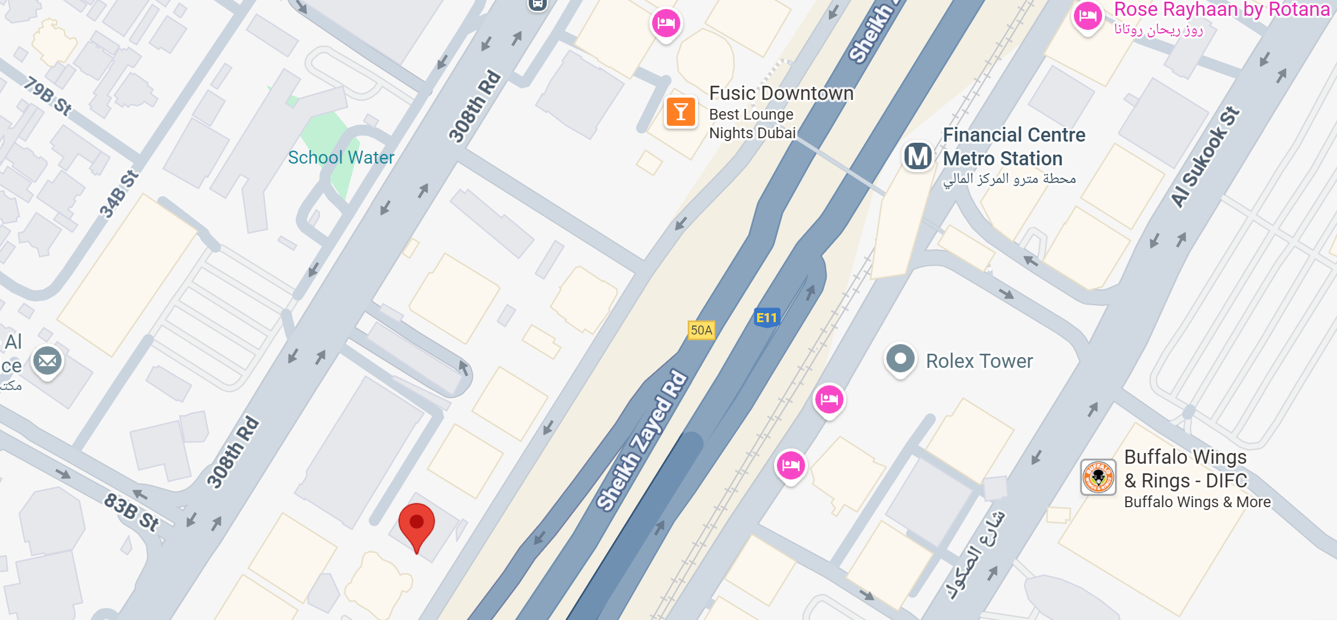
Click here for
GOOGLE MAP
We Are Here…!
20th floor Aspin Commercial Tower, Sheikh Zayed Road, Dubai,
United Arab Emirates
DPD REAL ESTATE
Phone: +971585584499
Email: info@dpdrealestate.com

Slide 11

Do you have any questions?
Contact me.
BASHIR GHANI ZADA
FOUNDER
DPD REAL ESTATE
Phone | 971585584499
Email website | info@dpdrealestate.com www.dpdrealestate.com
Company | DPD Real Estate LLC
VERIFIED

